Slide 1



Taming and Dissecting Recursions through Interprocedural Weak Topological Ordering
Jiawei Yang^{#1}, Xiao Cheng^{#2}, Bor-yuh Chang³, Xiapu Luo¹, Yulei Sui²
¹
²
³
Notes:
Good morning, everyone.
I am jiawei, an MPhil student at the Hong Kong Polytechnic University.
Today, I am horned to be here to introduce our recent work on abstract interperation, which focuses on handling recursions through weak topological ordering.
This is a cowork with xiao and other researchers from the university of new south wales and the univeristy of colorado boulder.

Slide 2
Contributions
RecTopo, a new fixpoint computation approach for precise interprocedural abstract interpretation on programs with recursions.
A scalable algorithm for constructing Interprocedural Weak Topological Ordering (IWTO).
Emperical evaluation on 8312 NIST programs and 10 real-world projects demonstrates RecTopo's precision and recall improvement.
Notes:
To the best of our knowledge, the state of the arts faces challenge on handling recursions.
There are either unsound or imprecise. On the one hand, Pinpoint unrolls recursion for fixed depth, and astree bound the analysis of recursive calls, which are both unsound.
On the other hand, ikos assigns top values to the affected values of recursions, while CSA and Clam only performs widening at recursion entry/exit nodes, failing to improve precision using narrowing.
Our aim is to leverage weak topological ordering to handle recursions, while avoid spurious cycles.
The challenge lies in that, a context sensitive WTO construction on ICFG is prohibitive and impratical for real world programs which are usually large in size.
Less conservative.

Slide 3
Abstract Interpretation
Foundational framework for expressing static program analysis.
Soundly approximate potential runtime behaviours of a program.
Applications:
Security Analysis
Software Verification
Compiler Optimization
Notes:
To begin with, I will present some background knowledge about abstract interperation.
Abstract Interpreatation is a foundational framework for expressing static program analysis.
It aims at soundly approximating potential runtime behavious of program.
It's applications include compiler optimization, software verification, and security analysis.

Slide 4
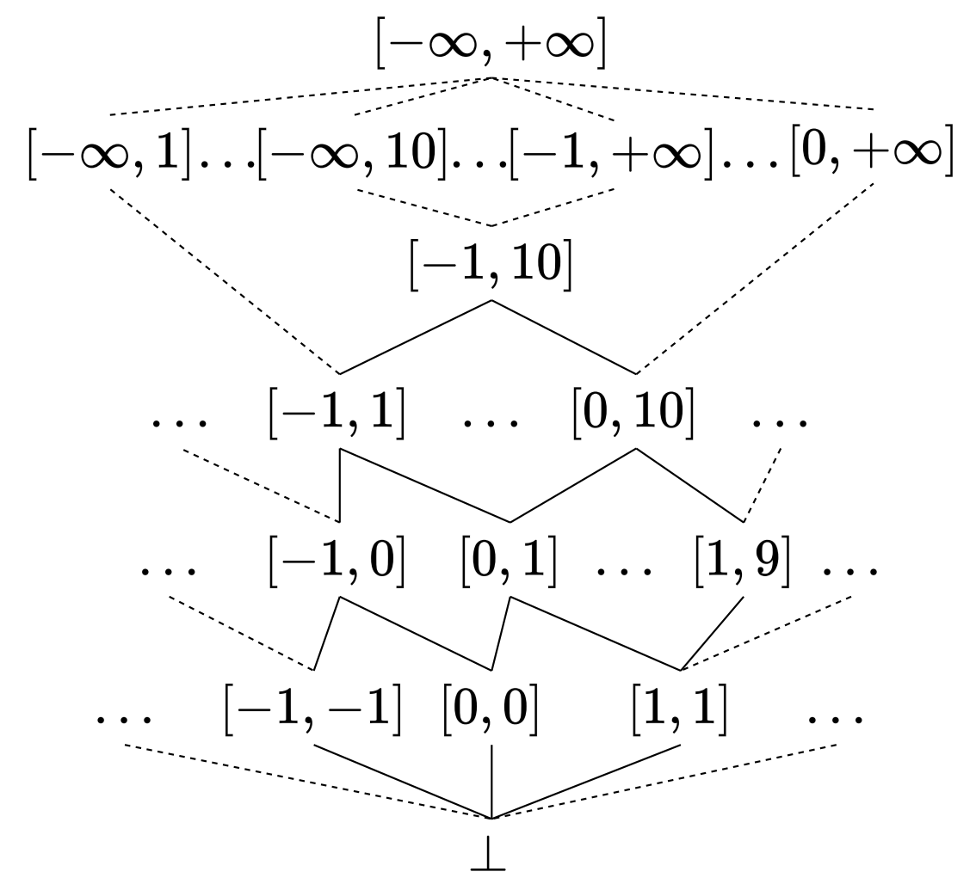

Abstract Interpretation
Abstract domain $𝔸$
if (input)
x = 0;
else
x = 1;
print(x)
x could be 0 or 1
when printed.
Source Code
Integer Interval domain
Notes:
Instead of working with precise values, it uses abstract domains to over-approximate the runtime values of variables.
For example, take a look at the code on the left. It’s a simple branch statement that assigns 0 and 1 to x depending on the condition. By the last line, x could be either 0 or 1 when printed.
Now, rather than tracking the exact values, we introduce abstract domains to represent this information.
Let’s consider two ways to approximate x. The first is sign domain, as show in the central figure. We can use the set of zero and positive to represent this information

Slide 5
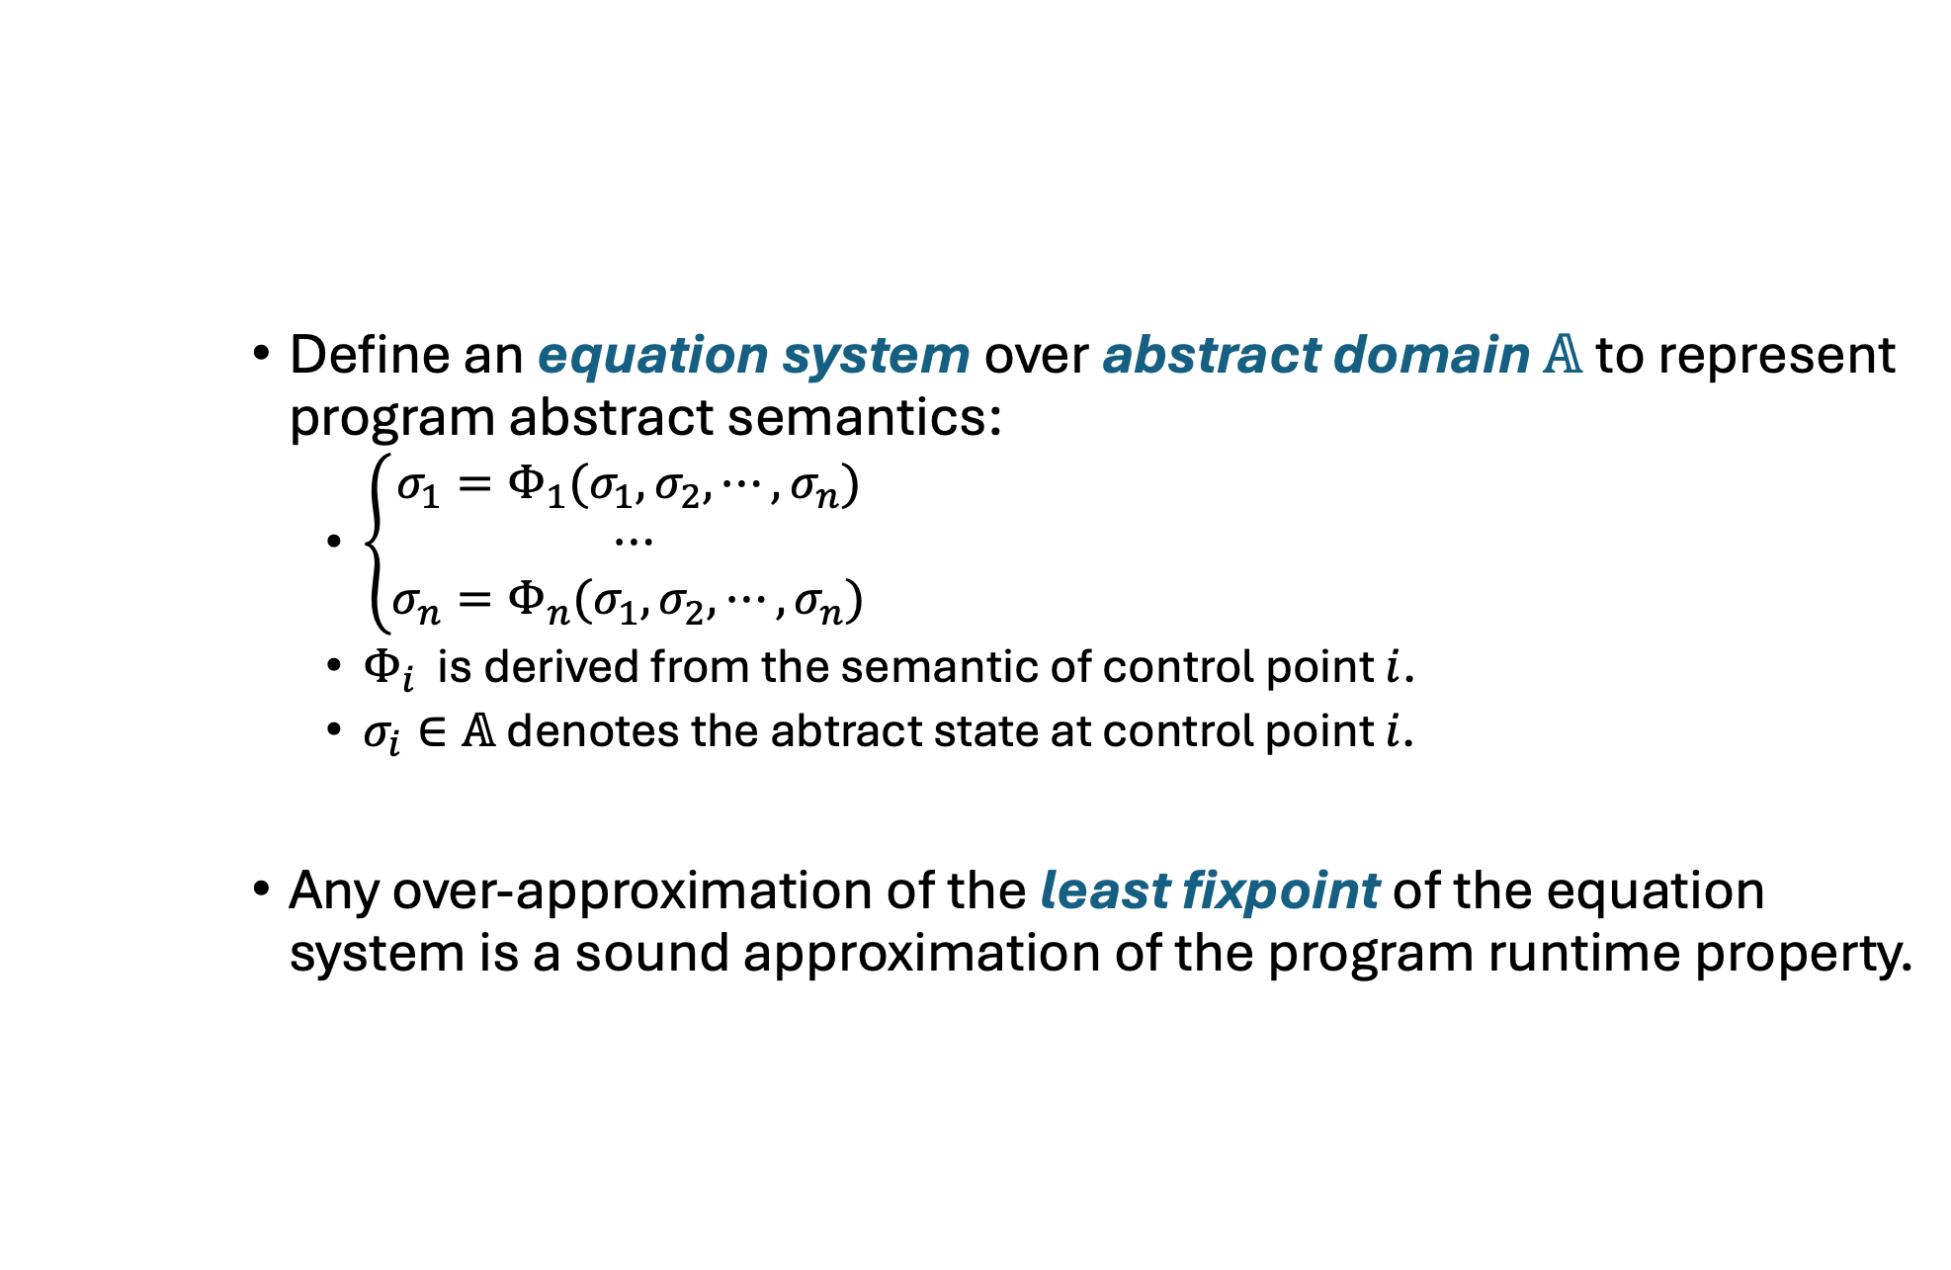
Abstract Interpretation
Define an equation system over abstract domain $𝔸$ to represent program abstract semantics:
$\left\{\begin{aligned}σ_{1}=Φ_{1}(σ_{1},σ_{2},⋯,σ_{n}) \\ ⋯ \\ σ_{n}=Φ_{n}(σ_{1},σ_{2},⋯,σ_{n}) \end{aligned}\right.$
$Φ_{i}$ is derived from the semantic of control point $i$.
$σ_{i}∈𝔸$ denotes the abtract state at control point $i$.
Any over-approximation of the least fixpoint of the equation system is a sound approximation of the program runtime property.
Notes:
Abstract Interpretation can be formalized using an equation system over abstract domain, which represents the abstract semantics of a program.
The equation sytem consisits of several euqations. The i th equation is derived from the semantic of each control point i in the program. and sigma i represents the abstract state at the control point i.
Based on the equation system, we can obtain a sound approximation of the program runtime behaviours by computing an over-approximation of the least fixpoint of the equation system.

Slide 6
Abstract Interpretation
Equation System
int i = 0;
while (i < 10)
i++;
...
Code
Notes:
The code on the left is a simple while loop that increments i by one in each iteration, untill it becomes 10.

Slide 7
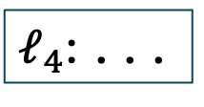

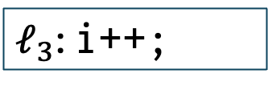

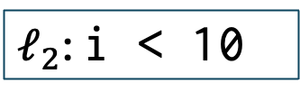
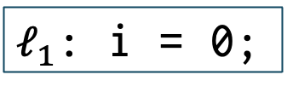
Abstract Interpretation
Equation System
$𝓁_{1}$: i = 0;
int i = 0;
while (i < 10)
i++;
...
$𝓁_{2}$: i < 10
$$i <10$$
$$i ≥10$$
$𝓁_{3}$: i++;
$𝓁_{4}$: ...
Code
Control flow graph (CFG)
Notes:
The graph in the middle is a control flow graph, namely cfg, constructed from the code on the left

Slide 8
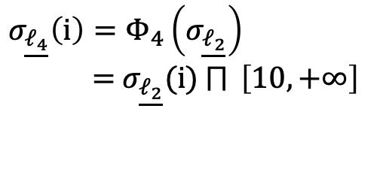
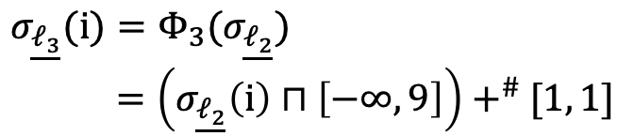
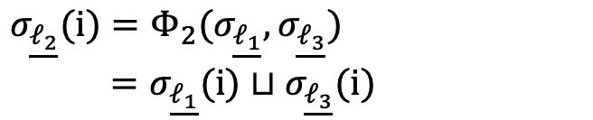
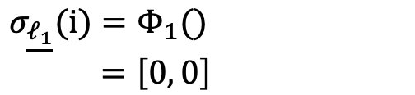
Abstract Interpretation
Equation System
$$σ_{\underline{𝓁_{1}}}(i)=Φ_{1}()$$
$=\left[0, 0\right]$
$𝓁_{1}$: i = 0;
int i = 0;
while (i < 10)
i++;
...
$$σ_{\underline{𝓁_{2}}}(i)=Φ_{2}(σ_{\underline{𝓁_{1}}},σ_{\underline{𝓁_{3}}})$$
$=σ_{\underline{𝓁_{1}}}(i)⊔σ_{\underline{𝓁_{3}}}(i)$
$𝓁_{2}$: i < 10
$$σ_{\underline{𝓁_{3}}}(i)=Φ_{3}(σ_{\underline{𝓁_{2}}})$$
$=\left(σ_{\underline{𝓁_{2}}}\left(i\right)⊓\left[−∞, 9\right]\right)+^{\#}[1, 1]$
$$i <10$$
$$i ≥10$$
$𝓁_{3}$: i++;
$𝓁_{4}$: ...
$$σ_{\underline{𝓁_{4}}}\left(i\right)=Φ_{4}\left(σ_{\underline{𝓁_{2}}}\right)$$
$=$ $σ_{\underline{𝓁_{2}}}(i)$ $⨅{ \left[10, +∞\right]}$
Code
Control flow graph (CFG)
Equation System
Notes:
Then we define an quation for each control point in the CFG based on the semantic of the corresponding control point.
All the four equations combines to form the equation system that represents the abstract semantic of the program.

Slide 9


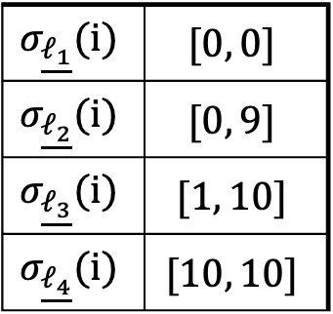
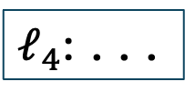

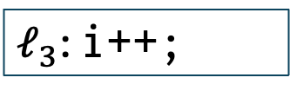



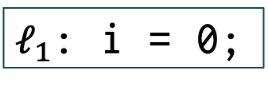

Abstract Interpretation
Fixpoint Computation
$𝓁_{1}$: i = 0;
$$σ_{\underline{𝓁_{1}}}(i)=Φ_{1}(…)$$
$$σ_{\underline{𝓁_{1}}}(i)$$ | $$[0, 0]$$
$$σ_{\underline{𝓁_{2}}}(i)$$ | $$[0, 9]$$
$$σ_{\underline{𝓁_{3}}}(i)$$ | $$[1, 10]$$
$$σ_{\underline{𝓁_{4}}}(i)$$ | $$[10, 10]$$
$$σ_{\underline{𝓁_{2}}}(i)=Φ_{2}(…)$$
$𝓁_{2}$: i < 10
Fixpiont Computation
$$i <10$$
$$i ≥10$$
$$σ_{\underline{𝓁_{3}}}(i)=Φ_{3}(…)$$
$𝓁_{3}$: i++;
$𝓁_{4}$: ...
$$σ_{\underline{𝓁_{4}}}\left(i\right)=Φ_{4}\left(…\right)$$
Least Fixpoint
Equation System
(a sound approximation of the program runtime property)
Notes:
Now that we have the euqation system, we perform a fixpoint computation to derive a approximation of the least fixpoint of the equation system, which is a sound approximiation fo the program runtime behaviour.

Slide 10
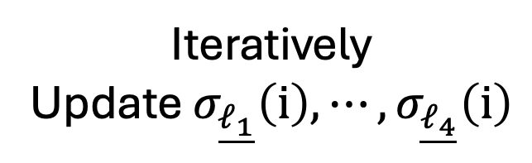
Abstract Interpretation
Fixpoint Computation
$𝓁_{1}$: i = 0;
$$σ_{\underline{𝓁_{1}}}(i)=Φ_{1}(…)$$
$$σ_{\underline{𝓁_{1}}}(i)$$ | $$[0, 0]$$
$$σ_{\underline{𝓁_{2}}}(i)$$ | $$[0, 9]$$
$$σ_{\underline{𝓁_{3}}}(i)$$ | $$[1, 10]$$
$$σ_{\underline{𝓁_{4}}}(i)$$ | $$[10, 10]$$
$$σ_{\underline{𝓁_{2}}}(i)=Φ_{2}(…)$$
$𝓁_{2}$: i < 10
Fixpiont Computation
$$i <10$$
$$i ≥10$$
$$σ_{\underline{𝓁_{3}}}(i)=Φ_{3}(…)$$
$𝓁_{3}$: i++;
$𝓁_{4}$: ...
Iteratively
Update $σ_{\underline{𝓁_{1}}}\left(i\right),⋯,σ_{\underline{𝓁_{4}}}\left(i\right)$
$$σ_{\underline{𝓁_{4}}}\left(i\right)=Φ_{4}\left(…\right)$$
Least Fixpoint
Equation System
(a sound approximation of the program runtime property)
Notes:
Naive fixpoint compuation requires to iteratively upate the abstract state of Line1, Line 2, to Line 4, until none of them changes, namely, reaches a fixpoint.

Slide 11
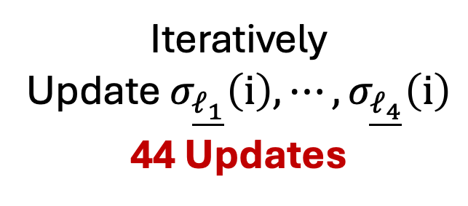
Abstract Interpretation
Fixpoint Computation
$𝓁_{1}$: i = 0;
$$σ_{\underline{𝓁_{1}}}(i)=Φ_{1}(…)$$
$$σ_{\underline{𝓁_{1}}}(i)$$ | $$[0, 0]$$
$$σ_{\underline{𝓁_{2}}}(i)$$ | $$[0, 9]$$
$$σ_{\underline{𝓁_{3}}}(i)$$ | $$[1, 10]$$
$$σ_{\underline{𝓁_{4}}}(i)$$ | $$[10, 10]$$
$$σ_{\underline{𝓁_{2}}}(i)=Φ_{2}(…)$$
$𝓁_{2}$: i < 10
Fixpiont Computation
$$i <10$$
$$i ≥10$$
$$σ_{\underline{𝓁_{3}}}(i)=Φ_{3}(…)$$
$𝓁_{3}$: i++;
$𝓁_{4}$: ...
Iteratively
Update $σ_{\underline{𝓁_{1}}}\left(i\right),⋯,σ_{\underline{𝓁_{4}}}\left(i\right)$
44 Updates
$$σ_{\underline{𝓁_{4}}}\left(i\right)=Φ_{4}\left(…\right)$$
Least Fixpoint
Equation System
(a sound approximation of the program runtime property)
Notes:
In this example, it needs 44 updates to reach this fixpoint.

Slide 12
Abstract Interpretation
Bourdoncle's Fixpoint Computation
$𝓁_{1}$: i = 0;
$$σ_{\underline{𝓁_{1}}}(i)=Φ_{1}(…)$$
Bourdoncle's
Fixpiont Computation (Bourdoncle, 2005)
$$σ_{\underline{𝓁_{1}}}(i)$$ | $$[0, 0]$$
$$σ_{\underline{𝓁_{2}}}(i)$$ | $$[0, 9]$$
$$σ_{\underline{𝓁_{3}}}(i)$$ | $$[1, 10]$$
$$σ_{\underline{𝓁_{4}}}(i)$$ | $$[10, 10]$$
$$σ_{\underline{𝓁_{2}}}(i)=Φ_{2}(…)$$
$𝓁_{2}$: i < 10
$$i <10$$
$$i ≥10$$
$$σ_{\underline{𝓁_{3}}}(i)=Φ_{3}(…)$$
$𝓁_{3}$: i++;
$𝓁_{4}$: ...
44 Updates
12 Updates
$$σ_{\underline{𝓁_{4}}}\left(i\right)=Φ_{4}\left(…\right)$$
Least Fixpoint
Equation System
(a sound approximation of the program runtime property)
Bourdoncle, F. (2005, June). Efficient chaotic iteration strategies with widenings. In Formal methods in programming and their applications: international conference academgorodok, Novosibirsk, Russia June 28–July 2, 1993 proceedings (pp. 128-141). Berlin, Heidelberg: Springer Berlin Heidelberg.
Notes:
Bourdoncle introduce a more efficient fixpoint compuation appraoch which can reduce the number of updates from 44 to 12.

Slide 13
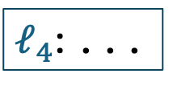
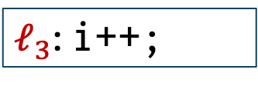
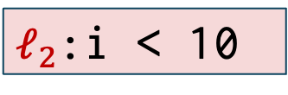
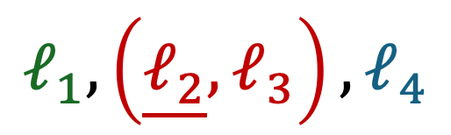
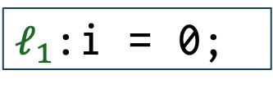


Abstract Interpretation
Bourdoncle's fixpoint computation
$𝓁_{1}$:i = 0;
Loop Head
$𝓁_{2}$:i < 10
$$𝓁_{1}, \left(\underline{𝓁_{2}},𝓁_{3}\right),𝓁_{4}$$
$$i <10$$
$$i ≥10$$
Weak Topological Ordering
(WTO)
$𝓁_{3}$: i++;
$𝓁_{4}$: ...
Loop
Control Flow Graph (CFG)
Notes:
Bourdoncle's fixpiont computation first analyze the CFG of the program and recognize the loop and loop head in the CFG.
The derived information can be formlized using Weak Topological Ordering, which is a well parathesized sequence of control points.

Slide 14
Abstract Interpretation
Bourdoncle's fixpoint computation
$𝓁_{1}$:i = 0;
Widening/Narrowing
$𝓁_{2}$:i < 10
$$𝓁_{1}, \left(\underline{𝓁_{2}},𝓁_{3}\right),𝓁_{4}$$
$$i <10$$
$$i ≥10$$
Weak Topological Ordering
(WTO)
$𝓁_{3}$: i++;
$𝓁_{4}$: ...
Control Flow Graph (CFG)
Notes:
It then use WTO to guide the fixpoint computation, specifically, it performs widening and narrowing on the loop head to accelarate convergence while perserve precision.

Slide 15
Abstract Interpretation
Bourdoncle's fixpoint computation
Loop
Recursion
?
Fixpoint computation with
interleaved widening and narrowing
guided by WTO
Notes:
Now that we can benifit from WTO for guideing the widening and narrowing in the loop, how can we extend the benifit to handling recurisions?

Slide 16
Motivation
Recursion handling
1 int recur(int p) {
2 if (p > 100) {
3 return p – 10;
4 } else {
5 return recur(p + 11);
6 }
7 }
8 int main() {
9 int res1 = recur(105);
10 int res2 = recur(res1);
11 }
Code
Notes:
Despite the effacacy of bourdoncle's fixpoint computation, it is faces challege to extend to recursive programs.
Here is an example. The left figure is a recursive program. The recur function calls itself at line 5. And the main func calls recur at line 9 and 10 respectively.

Slide 17
Motivation
Recursion handling
1 int recur(int p) {
2 if (p > 100) {
3 return p – 10;
4 } else {
5 return recur(p + 11);
6 }
7 }
8 int main() {
9 int res1 = recur(105);
10 int res2 = recur(res1);
11 }
Code
Interprocedural Control Flow Graph (ICFG)
Notes:
Then, we look at the interprocedural control flow graph of this program.

Slide 18







Motivation
$$𝓁_{1}$$
Recursion handling
$$𝓁_{2}$$
1 int recur(int p) {
2 if (p > 100) {
3 return p – 10;
4 } else {
5 return recur(p + 11);
6 }
7 }
8 int main() {
9 int res1 = recur(105);
10 int res2 = recur(res1);
11 }
$$𝓁_{3}$$
$$𝓁_{5}^{c}$$
$$𝓁_{5}^{r}$$
$$𝓁_{6}$$
$$𝓁_{7}$$
Call Edge
Return Edge
Code
Interprocedural Control Flow Graph (ICFG)
Notes:
The right figure is the control flow graph of the recur function solely.

Slide 19


Motivation
$$𝓁_{1}$$
Recursion handling
$$𝓁_{2}$$
1 int recur(int p) {
2 if (p > 100) {
3 return p – 10;
4 } else {
5 return recur(p + 11);
6 }
7 }
8 int main() {
9 int res1 = recur(105);
10 int res2 = recur(res1);
11 }
Call Node
$$𝓁_{3}$$
$$𝓁_{5}^{c}$$
$$𝓁_{5}^{r}$$
Return Node
$$𝓁_{6}$$
$$𝓁_{7}$$
Call Edge
Return Edge
Code
Interprocedural Control Flow Graph (ICFG)
Notes:
It should be noted that each call statement in the graph corresponds to two node in the CFG.

Slide 20
Motivation
$$𝓁_{1}$$
Recursion handling
Cycle 1
$$𝓁_{2}$$
1 int recur(int p) {
2 if (p > 100) {
3 return p – 10;
4 } else {
5 return recur(p + 11);
6 }
7 }
8 int main() {
9 int res1 = recur(105);
10 int res2 = recur(res1);
11 }
$$𝓁_{3}$$
$$𝓁_{5}^{c}$$
$$𝓁_{5}^{r}$$
$$𝓁_{6}$$
Cycle 2
$$𝓁_{7}$$
Call Edge
Return Edge
Code
Interprocedural Control Flow Graph (ICFG)
Notes:
There are two cycles in the control flow graph, as high lighted in red. This code in these two cycles could be executed repeatedly for uncertain times.

Slide 21



Motivation
$$𝓁_{8}$$
$$𝓁_{1}$$
Recursion handling
$$𝓁_{9}^{c}$$
$$𝓁_{2}$$
1 int recur(int p) {
2 if (p > 100) {
3 return p – 10;
4 } else {
5 return recur(p + 11);
6 }
7 }
8 int main() {
9 int res1 = recur(105);
10 int res2 = recur(res1);
11 }
$$𝓁_{9}^{r}$$
$$𝓁_{3}$$
$$𝓁_{5}^{c}$$
$$𝓁_{5}^{r}$$
$$𝓁_{6}$$
$$𝓁_{7}$$
Call Edge
Return Edge
Code
Interprocedural Control Flow Graph (ICFG)
Notes:
Then, the line 9 in main function form three nodes in the introprocedural control flow graph (namely, ICFG).

Slide 22



Motivation
$$𝓁_{8}$$
$$𝓁_{1}$$
Recursion handling
$$𝓁_{9}^{c}$$
$$𝓁_{2}$$
1 int recur(int p) {
2 if (p > 100) {
3 return p – 10;
4 } else {
5 return recur(p + 11);
6 }
7 }
8 int main() {
9 int res1 = recur(105);
10 int res2 = recur(res1);
11 }
$$𝓁_{9}^{r}$$
$$𝓁_{3}$$
$$𝓁_{5}^{c}$$
$$𝓁_{5}^{r}$$
$$𝓁_{10}^{c}$$
$$𝓁_{10}^{r}$$
$$𝓁_{6}$$
$$𝓁_{11}$$
$$𝓁_{7}$$
Call Edge
Return Edge
Code
Interprocedural Control Flow Graph (ICFG)
Notes:
Similarly, line 10 also contributes 3 nodes in the ICFG.

Slide 23
Motivation
$$𝓁_{8}$$
$$𝓁_{1}$$
Recursion handling
$$𝓁_{9}^{c}$$
$$𝓁_{2}$$
1 int recur(int p) {
2 if (p > 100) {
3 return p – 10;
4 } else {
5 return recur(p + 11);
6 }
7 }
8 int main() {
9 int res1 = recur(105);
10 int res2 = recur(res1);
11 }
$$𝓁_{9}^{r}$$
$$𝓁_{3}$$
$$𝓁_{5}^{c}$$
$$𝓁_{5}^{r}$$
$$𝓁_{10}^{c}$$
$$𝓁_{10}^{r}$$
$$𝓁_{6}$$
$$𝓁_{11}$$
$$𝓁_{7}$$
Call Edge
Return Edge
Code
Interprocedural Control Flow Graph (ICFG)
Notes:
Similarly, line 10 also contributes 3 nodes in the ICFG.

Slide 24
Motivation
$$𝓁_{8}$$
$$𝓁_{1}$$
Recursion handling
$$𝓁_{9}^{c}$$
$$𝓁_{2}$$
1 int recur(int p) {
2 if (p > 100) {
3 return p – 10;
4 } else {
5 return recur(p + 11);
6 }
7 }
8 int main() {
9 int res1 = recur(105);
10 int res2 = recur(res1);
11 }
$$𝓁_{9}^{r}$$
$$𝓁_{3}$$
$$𝓁_{5}^{c}$$
$$𝓁_{5}^{r}$$
$$𝓁_{10}^{c}$$
Cycle 3
$$𝓁_{10}^{r}$$
$$𝓁_{6}$$
$$𝓁_{11}$$
$$𝓁_{7}$$
Call Edge
Return Edge
Code
Interprocedural Control Flow Graph (ICFG)
Notes:
Now in the whole ICFG, we can recogize another big cycle, cycle3, wich starts from the call node at line 9, and go throught the recur function body finally returns to the call node at line 9.

Slide 25

Motivation
$$𝓁_{8}$$
$$𝓁_{1}$$
Recursion handling
$$𝓁_{9}^{c}$$
$$𝓁_{2}$$
1 int recur(int p) {
2 if (p > 100) {
3 return p – 10;
4 } else {
5 return recur(p + 11);
6 }
7 }
8 int main() {
9 int res1 = recur(105);
10 int res2 = recur(res1);
11 }
$$𝓁_{9}^{r}$$
$$𝓁_{3−5}$$
$$𝓁_{10}^{c}$$
Cycle 3
$$𝓁_{10}^{r}$$
$$𝓁_{6}$$
$$𝓁_{11}$$
$$𝓁_{7}$$
Call Edge
Return Edge
Code
Interprocedural Control Flow Graph (ICFG)
Notes:
We further analyze that this cycle3 still exits even when the recur function is repaced with a non-recursive definition.
Therefore, we can know that this cycle is solely introduced by the consecutive callsites in the program.
Meaning that unlike the cycles introduced by loops or recursions, the nodes in such cycle will not be executed for uncertain times.

Slide 26







Motivation
$$𝓁_{8}$$
$$𝓁_{1}$$
Recursion handling
$$𝓁_{9}^{c}$$
$$𝓁_{2}$$
1 int recur(int p) {
2 if (p > 100) {
3 return p – 10;
4 } else {
5 return recur(p + 11);
6 }
7 }
8 int main() {
9 int res1 = recur(105);
10 int res2 = recur(res1);
11 }
$$𝓁_{9}^{r}$$
$$𝓁_{3−5}$$
Spurious Cycle
$$𝓁_{10}^{c}$$
$$𝓁_{10}^{r}$$
$$𝓁_{6}$$
$$𝓁_{11}$$
$$𝓁_{7}$$
Call Edge
Return Edge
Code
Interprocedural Control Flow Graph (ICFG)
Notes:
Therefore, we consider this cycle 3 as a spurious cycle.

Slide 27











Motivation
$$𝓁_{8}$$
$$𝓁_{1}$$
Recursion handling
Redundant Widening Point
Imprecise
$$𝓁_{9}^{c}$$
$$𝓁_{2}$$
$$𝓁_{9}^{r}$$
$$𝓁_{3−5}$$
$$𝓁_{10}^{c}$$
Cycle 3
$$𝓁_{10}^{r}$$
$$𝓁_{6}$$
$$𝓁_{11}$$
$$𝓁_{7}$$
Call Edge
Return Edge
Interprocedural Control Flow Graph (ICFG)
Notes:
Even worse, if we perform widening on the recognized cycle head, we will lose precision due to the aggresive updates of widening.

Slide 28
Motivation
$$𝓁_{8}$$
$$𝓁_{1}$$
Recursion handling
$$𝓁_{9}^{c}$$
$$𝓁_{2}$$
$$𝓁_{9}^{r}$$
$$𝓁_{3−5}$$
Redundant cycle iterations
Inefficient
$$𝓁_{10}^{c}$$
Cycle 3
$$𝓁_{10}^{r}$$
$$𝓁_{6}$$
$$𝓁_{11}$$
$$𝓁_{7}$$
Call Edge
Return Edge
Interprocedural Control Flow Graph (ICFG)
Notes:
Therefore, if we compute a weak topological order on the whole ICFG, and use it to guide the Bourdoncle's fixpoint computation, it will introduce redundant cycle iterations, resulting inefficiency.

Slide 29
Motivation
Recursion handling
Tool | Recursion handling
Astrée (Cousot et al., 2005) | Bound the analysis of recursive calls
IKOS (Brat et al. 2014) | Assign top values to variables affected by recursion
PinPoint (Shi et al., 2021) | Unroll recursion for fixed depth
CSA (Cheng, Wang, &Sui, 2024), Clam (Gurfinkel & Navas, 2021) | Only perform widening at recursion entry/exit nodes
1 int recur(int p) {
2 if (p > 100) {
3 return p – 10;
4 } else {
5 return recur(p + 11);
6 }
7 }
8 int main() {
9 int res1 = recur(105);
10 int res2 = recur(res1);
11 }
Cousot, P., Cousot, R., Feret, J., Mauborgne, L., Miné, A., Monniaux, D., & Rival, X. (2005). The ASTRÉE analyzer. In Programming languages and systems: 14th European symposium on programming, ESOP 2005, held as part of the joint European conferences on theory and practice of software, ETAPS 2005, Edinburgh, UK, April 4-8, 2005. proceedings 14 (pp. 21-30). Springer Berlin Heidelberg.
Brat, G., Navas, J. A., Shi, N., & Venet, A. (2014, September). IKOS: A framework for static analysis based on abstract interpretation. In International Conference on Software Engineering and Formal Methods (pp. 271-277). Cham: Springer International Publishing.
Shi, Q., Yao, P., Wu, R., & Zhang, C. (2021). Path-sensitive sparse analysis without path conditions. In Proceedings of the 42nd ACM SIGPLAN International Conference on Programming Language Design and Implementation (PLDI 2021) (pp. 930–943). Association for Computing Machinery. https://doi.org/10.1145/3453483.3454086
Cheng, X., Wang, J., & Sui, Y. (2024, April). Precise Sparse Abstract Execution via Cross-Domain Interaction. In Proceedings of the IEEE/ACM 46th International Conference on Software Engineering (pp. 1-12).
Gurfinkel, A., & Navas, J. A. (2021, July). Abstract interpretation of LLVM with a region-based memory model. In International workshop on numerical software verification (pp. 122-144). Cham: Springer International Publishing.
Notes:
Despite the effacacy of bourdoncle's fixpoint computation, it is faces challege to extend to recursive programs.
Here is an example. The left figure is a recursive program. The recur function calls itself at line 5. And the main func calls recur at line 9 and 10 respectively.

Slide 30
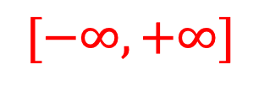
Motivation
Recursion handling
Tool | Recursion handling
Astrée (Cousot et al., 2005) | Bound the analysis of recursive calls
IKOS (Brat et al. 2014) | Assign top values to variables affected by recursion
PinPoint (Shi et al., 2021) | Unroll recursion for fixed depth
CSA (Cheng, Wang, &Sui, 2024), Clam (Gurfinkel & Navas, 2021) | Only perform widening at recursion entry/exit nodes
1 int recur(int p) {
2 if (p > 100) {
3 return p – 10;
4 } else {
5 return recur(p + 11);
6 }
7 }
8 int main() {
9 int res1 = recur(105);
10 int res2 = recur(res1);
11 }
$$[−∞, +∞]$$
Cousot, P., Cousot, R., Feret, J., Mauborgne, L., Miné, A., Monniaux, D., & Rival, X. (2005). The ASTRÉE analyzer. In Programming languages and systems: 14th European symposium on programming, ESOP 2005, held as part of the joint European conferences on theory and practice of software, ETAPS 2005, Edinburgh, UK, April 4-8, 2005. proceedings 14 (pp. 21-30). Springer Berlin Heidelberg.
Brat, G., Navas, J. A., Shi, N., & Venet, A. (2014, September). IKOS: A framework for static analysis based on abstract interpretation. In International Conference on Software Engineering and Formal Methods (pp. 271-277). Cham: Springer International Publishing.
Shi, Q., Yao, P., Wu, R., & Zhang, C. (2021). Path-sensitive sparse analysis without path conditions. In Proceedings of the 42nd ACM SIGPLAN International Conference on Programming Language Design and Implementation (PLDI 2021) (pp. 930–943). Association for Computing Machinery. https://doi.org/10.1145/3453483.3454086
Cheng, X., Wang, J., & Sui, Y. (2024, April). Precise Sparse Abstract Execution via Cross-Domain Interaction. In Proceedings of the IEEE/ACM 46th International Conference on Software Engineering (pp. 1-12).
Gurfinkel, A., & Navas, J. A. (2021, July). Abstract interpretation of LLVM with a region-based memory model. In International workshop on numerical software verification (pp. 122-144). Cham: Springer International Publishing.
Notes:
Despite the effacacy of bourdoncle's fixpoint computation, it is faces challege to extend to recursive programs.
Here is an example. The left figure is a recursive program. The recur function calls itself at line 5. And the main func calls recur at line 9 and 10 respectively.

Slide 31
Motivation
Recursion handling
Tool | Recursion handling
Astrée (Cousot et al., 2005) | Bound the analysis of recursive calls
IKOS (Brat et al. 2014) | Assign top values to variables affected by recursion
PinPoint (Shi et al., 2021) | Unroll recursion for fixed depth
CSA (Cheng, Wang, &Sui, 2024), Clam (Gurfinkel & Navas, 2021) | Only perform widening at recursion entry/exit nodes
1 int recur(int p) {
2 if (p > 100) {
3 return p – 10;
4 } else {
5 return recur(p + 11);
6 }
7 }
8 int main() {
9 int res1 = recur(105);
10 int res2 = recur(res1);
11 }
Unroll
Cousot, P., Cousot, R., Feret, J., Mauborgne, L., Miné, A., Monniaux, D., & Rival, X. (2005). The ASTRÉE analyzer. In Programming languages and systems: 14th European symposium on programming, ESOP 2005, held as part of the joint European conferences on theory and practice of software, ETAPS 2005, Edinburgh, UK, April 4-8, 2005. proceedings 14 (pp. 21-30). Springer Berlin Heidelberg.
Brat, G., Navas, J. A., Shi, N., & Venet, A. (2014, September). IKOS: A framework for static analysis based on abstract interpretation. In International Conference on Software Engineering and Formal Methods (pp. 271-277). Cham: Springer International Publishing.
Shi, Q., Yao, P., Wu, R., & Zhang, C. (2021). Path-sensitive sparse analysis without path conditions. In Proceedings of the 42nd ACM SIGPLAN International Conference on Programming Language Design and Implementation (PLDI 2021) (pp. 930–943). Association for Computing Machinery. https://doi.org/10.1145/3453483.3454086
Cheng, X., Wang, J., & Sui, Y. (2024, April). Precise Sparse Abstract Execution via Cross-Domain Interaction. In Proceedings of the IEEE/ACM 46th International Conference on Software Engineering (pp. 1-12).
Gurfinkel, A., & Navas, J. A. (2021, July). Abstract interpretation of LLVM with a region-based memory model. In International workshop on numerical software verification (pp. 122-144). Cham: Springer International Publishing.
Notes:
Despite the effacacy of bourdoncle's fixpoint computation, it is faces challege to extend to recursive programs.
Here is an example. The left figure is a recursive program. The recur function calls itself at line 5. And the main func calls recur at line 9 and 10 respectively.

Slide 32
Motivation
Recursion handling
Tool | Recursion handling
Astrée (Cousot et al., 2005) | Bound the analysis of recursive calls
IKOS (Brat et al. 2014) | Assign top values to variables affected by recursion
PinPoint (Shi et al., 2021) | Unroll recursion for fixed depth
CSA (Cheng, Wang, &Sui, 2024), Clam (Gurfinkel & Navas, 2021) | Only perform widening at recursion entry/exit nodes
1 int recur(int p) {
2 if (p > 100) {
3 return p – 10;
4 } else {
5 return recur(p + 11);
6 }
7 }
8 int main() {
9 int res1 = recur(105);
10 int res2 = recur(res1);
11 }
Widening
$$[−∞, +∞]$$
Cousot, P., Cousot, R., Feret, J., Mauborgne, L., Miné, A., Monniaux, D., & Rival, X. (2005). The ASTRÉE analyzer. In Programming languages and systems: 14th European symposium on programming, ESOP 2005, held as part of the joint European conferences on theory and practice of software, ETAPS 2005, Edinburgh, UK, April 4-8, 2005. proceedings 14 (pp. 21-30). Springer Berlin Heidelberg.
Brat, G., Navas, J. A., Shi, N., & Venet, A. (2014, September). IKOS: A framework for static analysis based on abstract interpretation. In International Conference on Software Engineering and Formal Methods (pp. 271-277). Cham: Springer International Publishing.
Shi, Q., Yao, P., Wu, R., & Zhang, C. (2021). Path-sensitive sparse analysis without path conditions. In Proceedings of the 42nd ACM SIGPLAN International Conference on Programming Language Design and Implementation (PLDI 2021) (pp. 930–943). Association for Computing Machinery. https://doi.org/10.1145/3453483.3454086
Cheng, X., Wang, J., & Sui, Y. (2024, April). Precise Sparse Abstract Execution via Cross-Domain Interaction. In Proceedings of the IEEE/ACM 46th International Conference on Software Engineering (pp. 1-12).
Gurfinkel, A., & Navas, J. A. (2021, July). Abstract interpretation of LLVM with a region-based memory model. In International workshop on numerical software verification (pp. 122-144). Cham: Springer International Publishing.
Notes:
Despite the effacacy of bourdoncle's fixpoint computation, it is faces challege to extend to recursive programs.
Here is an example. The left figure is a recursive program. The recur function calls itself at line 5. And the main func calls recur at line 9 and 10 respectively.

Slide 33
Motivation
Recursion handling
Our aim: Leverage weak topological ordering to handle recursions precisely, while avoiding spurious cycles.
Challenge: Context sensitive WTO construction is prohibitive (exponential complexity)!

Slide 34
Approach
Overview
Three-fold approach
Step 1: Identify function partitions on a pre-built call graph.
Step 2: For each function partition, build inter-procedural weak topological ordering (IWTO).
Step 3: Use the IWTO to guide abstract interpretation.
Notes:
To solve tackle this challenge, we introduce a three-fold approach.
Firstly, we identify function partitions on a pre-build call graph.
Then, for each function partition, we build Weak Topological Ordering interprocedurally on its sub ICFG, which is referred as Interprocedural Weak Topological Ordering (namely IWTO).
Finally, we use these IWTOs to guide our abstract interpretation.

Slide 35
Approach
Step 1: Function partition identification
1 int recur(int p) {
2 if (p > 100) {
3 return p – 10;
4 } else {
5 return recur(p + 11);
6 }
7 }
8 int main() {
9 int res1 = recur(105);
10 int res2 = recur(res1);
11 }
main
recur
Partition 1
Partition 2
Code
Call Graph
Notes:
I will explain our approach using the same exmaple.
As shown on the right, the call graph consists of two nodes. And recur has a selp loop due to the recursion.
The first step identifies the function partitions through applying Tarjan's SCC algorihtm on the call graph.
Each recognized SCC forms a function partion.
In this example, the main function forms a partion solely, and recur forms another partition.

Slide 36
Approach
Step 2: IWTO construction
main
recur
Partition 1
Partition 2
Call Graph
Notes:
Then we extract a sub ICFG for each function parition.
Add ICFG.

Slide 37













Approach
Step 2: IWTO construction
$$𝓁_{8}$$
$$𝓁_{1}$$
Partition 1
Partition 2
$$𝓁_{9}^{c}$$
$$𝓁_{2}$$
$$𝓁_{9}^{r}$$
$$𝓁_{3}$$
$$𝓁_{5}^{c}$$
$$𝓁_{5}^{r}$$
main
recur
$$𝓁_{10}^{c}$$
$$𝓁_{10}^{r}$$
$$𝓁_{6}$$
Partition 1
Partition 2
$$𝓁_{11}$$
$$𝓁_{7}$$
Call Edge
Return Edge
Call Graph
Interprocedural Control Flow Graph
Notes:
Then we extract a sub ICFG for each function parition.
Add ICFG.

Slide 38



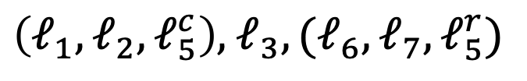











Approach
Step 2: IWTO construction
$$𝓁_{8}$$
$$𝓁_{1}$$
Partition 1
Partition 2
$$𝓁_{9}^{c}$$
$$𝓁_{2}$$
$$𝓁_{8},𝓁_{9}^{c},𝓁_{9}^{r},𝓁_{10}^{c},𝓁_{10}^{r},𝓁_{11}$$
$$𝓁_{9}^{r}$$
$$𝓁_{3}$$
$$𝓁_{5}^{c}$$
Complement Sub-ICFG
Partition 1
$$𝓁_{5}^{r}$$
$$𝓁_{10}^{c}$$
$$𝓁_{10}^{r}$$
$$𝓁_{6}$$
$\left(𝓁_{1},𝓁_{2},𝓁_{5}^{c}\right),$ $𝓁_{3},(𝓁_{6},𝓁_{7},𝓁_{5}^{r})$
Partition 2
$$𝓁_{11}$$
$$𝓁_{7}$$
Call Edge
IWTO
Return Edge
Interprocedural Control Flow Graph
Notes:
Followed by that, we also need to complement the sub ICFG of the first parition through adding edges between non-recursive all and return sites. So that the whole graph is connected.
After that, we construct the IWTO for the sub ICFG of each function partition.
For example, the IWTO for partition 1 is straight forward sequence.
And the IWTO for partition 2 involes two cycles.

Slide 39
Abstract Interpretation
Step 3: IWTO guided abstract interpretation
Loop
Recursion
Fixpoint computation with
interleaved widening and narrowing
guided by WTO
Fixpoint computation with
interleaved widening and narrowing
guided by IWTO
Notes:
Until the abstract state line 2, does not change, meannig the updating stabilizes within this loop. This is because line 2 is recognized as the head of the loop.

Slide 40
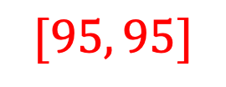
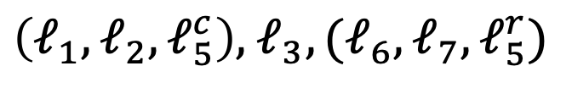

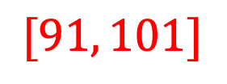
Approach
Step 3: IWTO guided abstract interpretation
$$𝓁_{8},𝓁_{9}^{c},𝓁_{9}^{r},𝓁_{10}^{c},𝓁_{10}^{r},𝓁_{11}$$
1 int recur(int p) {
2 if (p > 100) {
3 return p – 10;
4 } else {
5 return recur(p + 11);
6 }
7 }
8 int main() {
9 int res1 = recur(105);
10 int res2 = recur(res1);
11 }
Partition 1
$\left(𝓁_{1},𝓁_{2},𝓁_{5}^{c}\right),$ $𝓁_{3},(𝓁_{6},𝓁_{7},𝓁_{5}^{r})$
$$[95, 95]$$
Partition 2
IWTO
$$[91, 101]$$
Notes:
Despite the effacacy of bourdoncle's fixpoint computation, it is faces challege to extend to recursive programs.
Here is an example. The left figure is a recursive program. The recur function calls itself at line 5. And the main func calls recur at line 9 and 10 respectively.

Slide 41
Evaluation
Notes:
In order to evaluate the soundness and precision of our abstract interpreter, we implement a buffer overflow detector based on the abstract interpreation results.

Slide 42
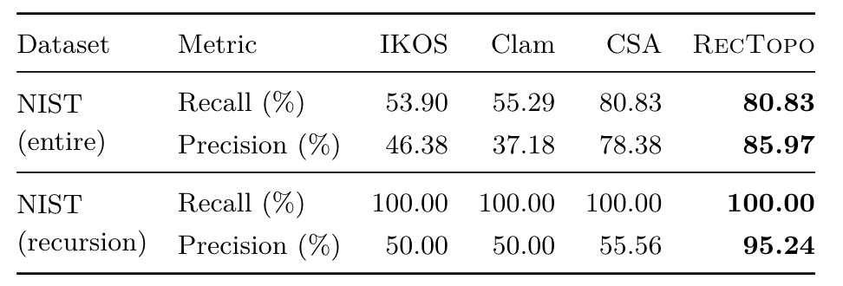
Results
Highest precision (avg. +31.99%)
RQ1: NIST benchmark
8312 programs from NIST dataset
Precision higher by 43.49% on average
Notes:
We first evaluate our detector on 8312 programs from NIST dataset that provides ground truth for buffer overflow bugs.
Part of them involves recursion.
We have choosed 3 state of the art open-sourced abstract interpreters as the baseline.
We found that our tool achieves that highest recall rete and precision rate compare to other three baseslines.
Notably, on the subset of cases involing recursion, we achieve an average 43.49% increment in precision rate.

Slide 43
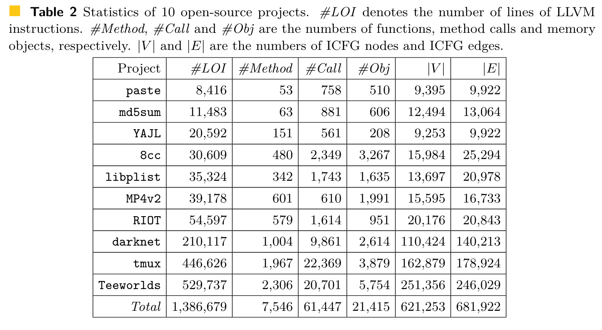
Results
RQ2: Real-world projects
Benchmark: 10 real-world projects
Notes:
We also tested our tool on 10 real-world projects of diverse functions.
Here is the statatistics of these projects. The largest of them, teeworlds, has five hundred thousands lines of instructions.

Slide 44
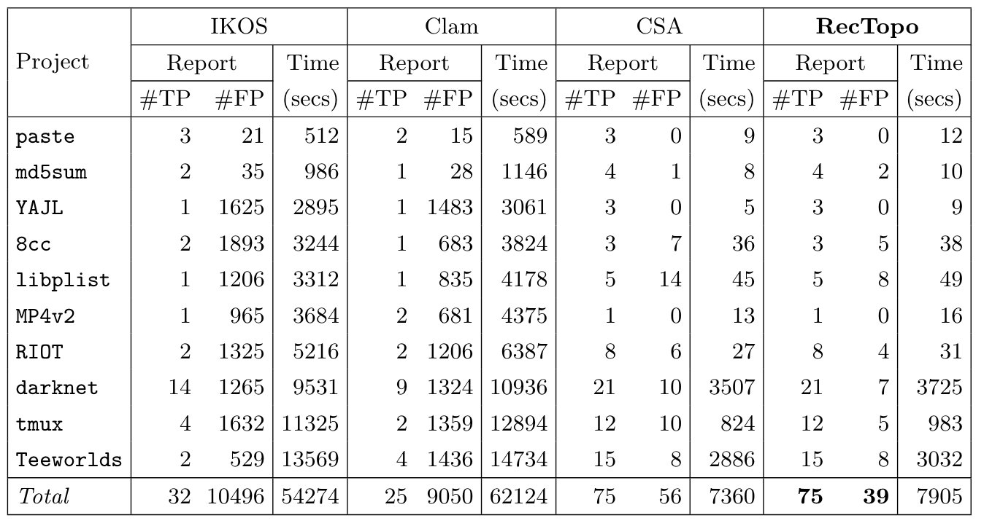
Results
Highest precision (avg. +46.51%)
RQ2: Real-world projects
Notes:
Here are the results of our tool compared with three other baseslines.
It is notable that our tool achieves the highest precision rate, which is higher than other tools by more than 40 %.
And the execution time is comparable to CSA.

Slide 45
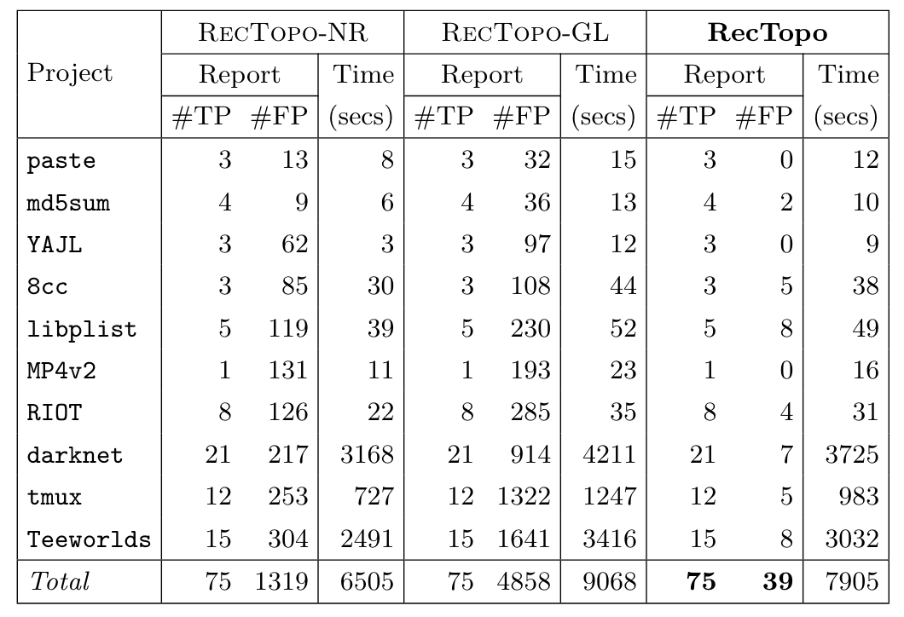
Results
Compared to RecTopo-NR, precision avg. +60.41%, with acceptable overheads.
RQ3: Ablation Analysis
RecTopo-NR: Skips recursive calls and assigns a top value.
RecTopo-GL: Integrates a whole-program global IWTO.
Notes:
In order understand the reason for our efficiency,
We also implemented two variation of our abstract interpretation, and compared them on the 10 real-world projects.
Rectopo-NR skips recursive calls and assigns a top value to the affected variables by the recursion.
While Rectopo-GL computes WTO on the whole ICFG, and follows it to perform bourdoncle's fixpoint commputation.
Compared RecTopo-NR, RecTopos exibits a sixty percent higher precision rate, with an acceptable overheads.

Slide 46
Results
RQ3: Ablation Analysis
RecTopo-NR: Skips recursive calls and assigns a top value.
RecTopo-GL: Integrates a whole-program global IWTO.
Compared to RecTopo-GL, precision avg. +64.27%,
accelarate 1.15x.
Notes:
Compared with RecTopo-GL, Retopo has an average 64 persent precision increment and also faster by one point fifteen times.

Slide 47
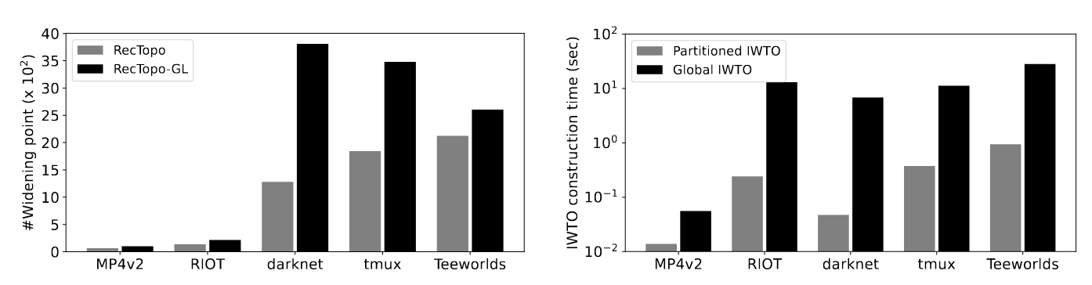
Results
RQ3: Ablation Analysis
Compared with RecTopo-GL, widening points reduced by 58.99%.
IWTO construction time accelarated by 36x.
Notes:
We further compared the widening point and IWTO construction time compare with the Rectopo-GL, which constructs WTO on the whole ICFG.
We found that our Parititoned IWTO construction reduces more than half of the widening points.
And is also 36 times faster than Global IWTO construction.

Slide 48

Conclusion
RecTopo, a new fixpoint computation approach for precise interprocedural abstract interpretation on programs with recursions.
A scalable algorithm for constructing IWTO.
Evaluation on 10 big projects demonstrates significant prcision improvements with minimal overheads.
Open sourced: https://github.com/JoelYYoung/RecTopo

